Slide 1
A Taste of Variability
Lisa Thomasen
Biometrics in the Bay of Islands 2023

Slide 2
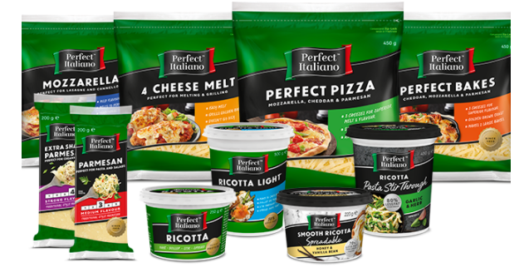
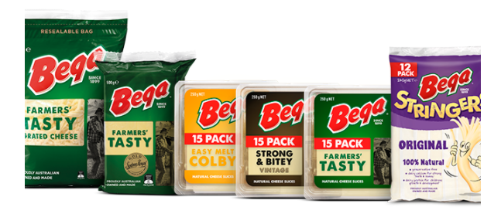

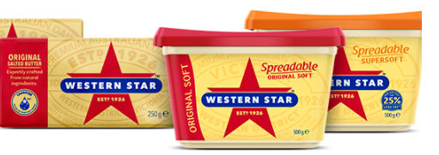
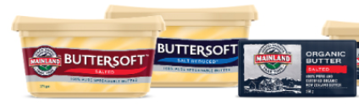
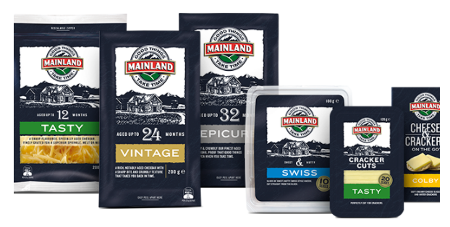
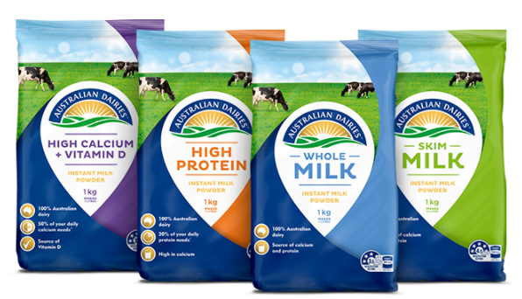
Notes:
Fonterra and its dairy brands are a household name in New Zealand – with regular mentions in the media. Fonterra also has a presence in Australia, so for all of you Australian statisticians, these are some of the Fonterra products you might see on your supermarket shelves – including Western Star butter & Mainland cheese

Slide 3
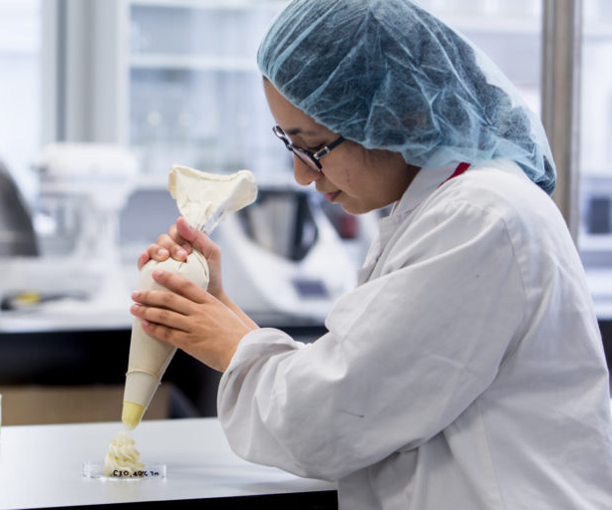
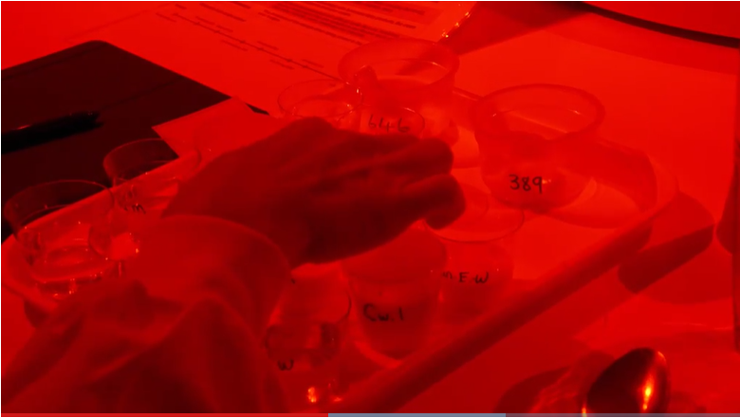
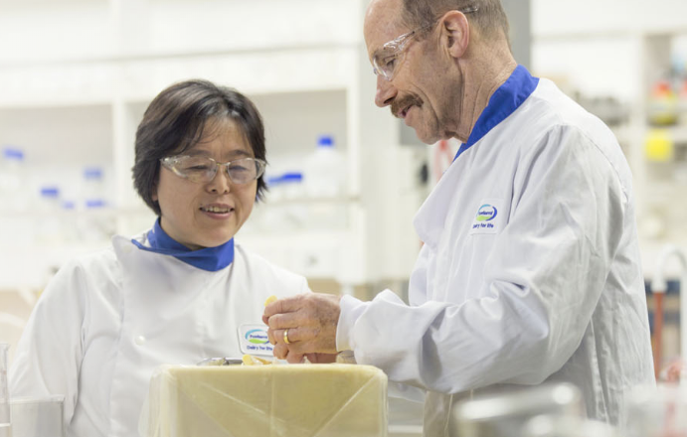

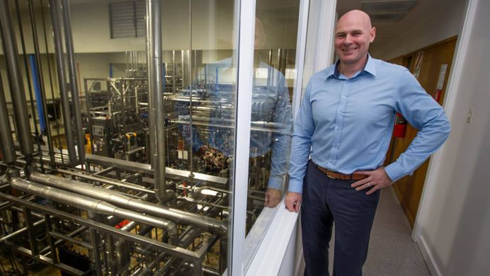
Notes:
Fonterra R&D – research and development to support the manufacture and of new dairy products and technologies

Slide 4
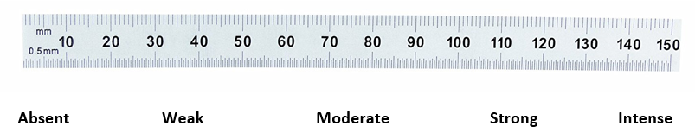
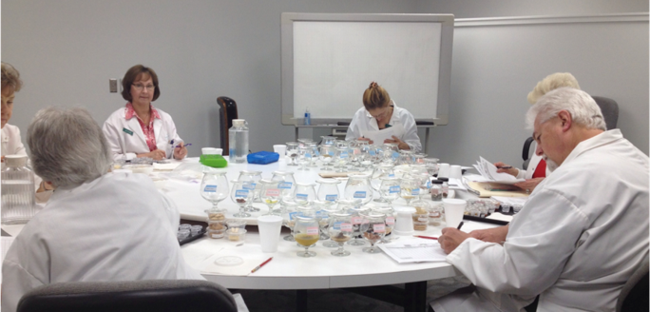
Sensory Panel Data
Notes:
Many methods
QDA – Quantitative Descrptive Analysis 0 – 150 Line Scale

Slide 5
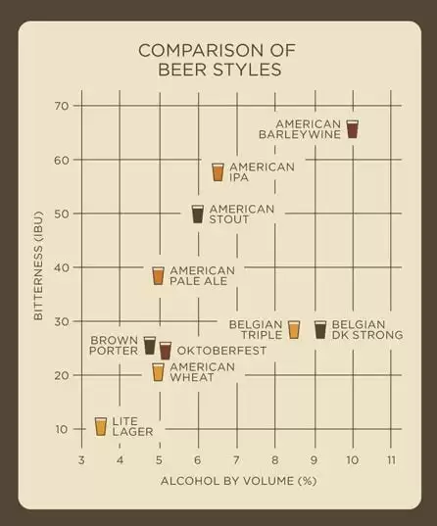
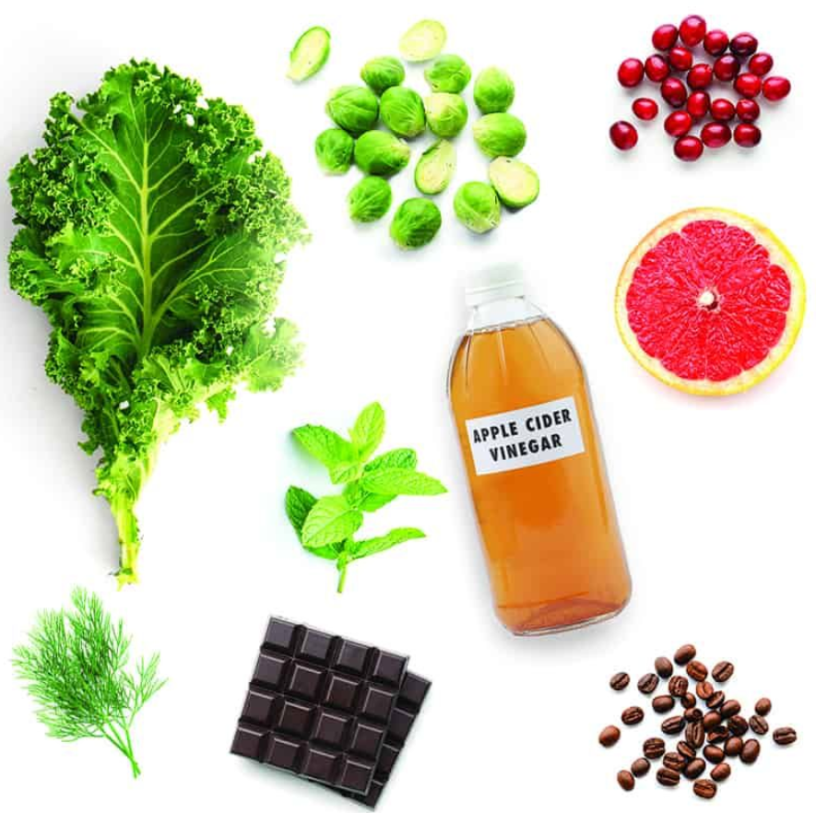
What is Bitterness?
A flavour which is pungent, sharp and lacking in sweetness.
Super-tasters are hyper sensitive to bitterness.
International Bittering Units (IBU)

Slide 6
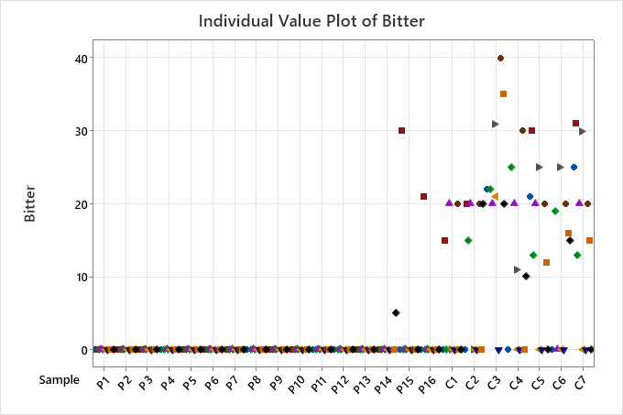
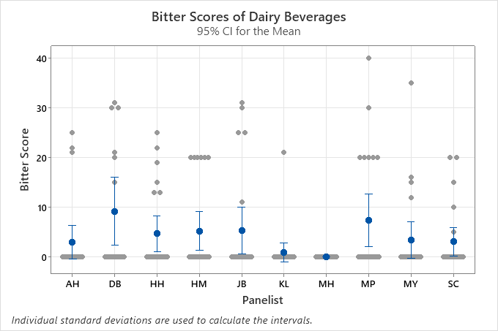
Bitterness & Non - perception

Slide 7
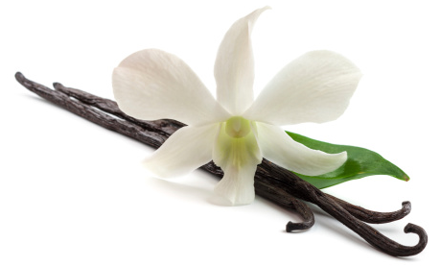
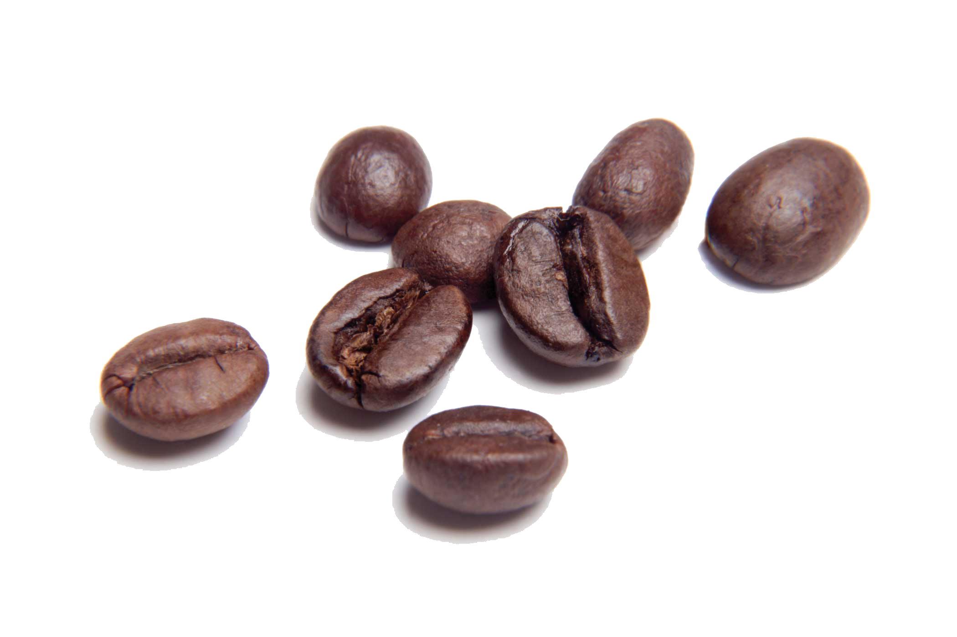
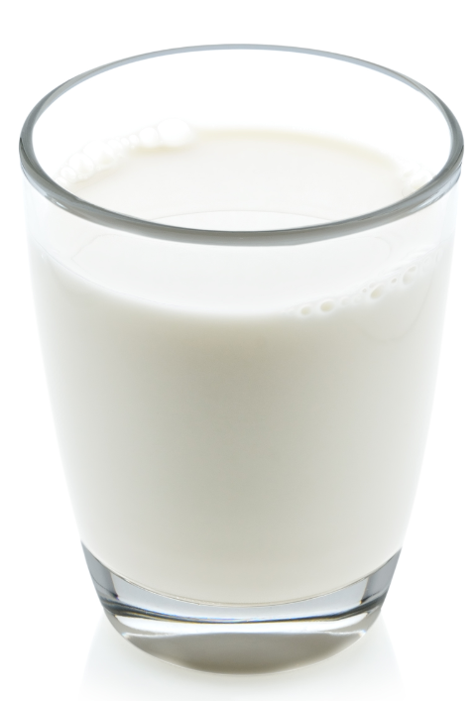
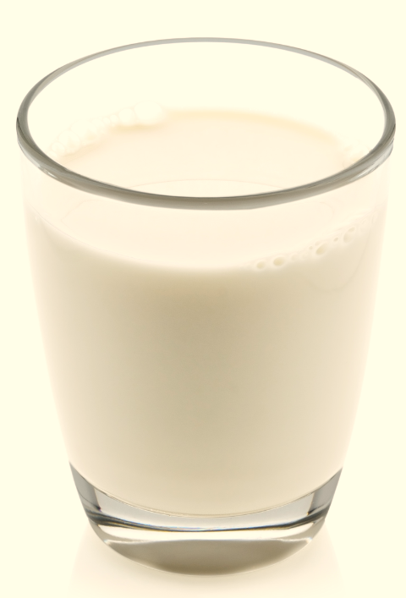
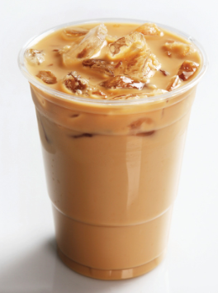
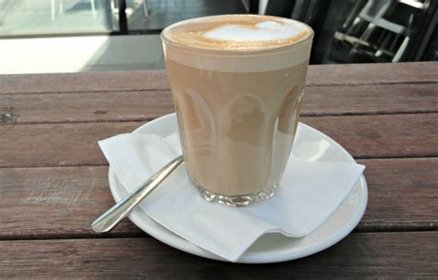
Non-perception & context

Slide 8
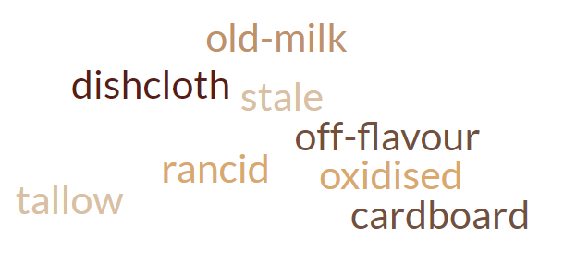
Shelf life & perception of off-flavours
Are non-perceivers of off-flavours early in shelf life true non-perceivers?
What is the detection threshold for each panelist?

Slide 9
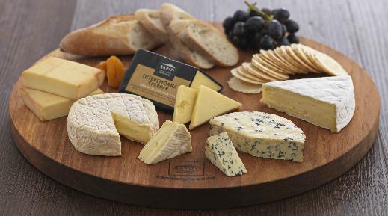
Should we remove non-perceivers?
Importance of sensory attribute to research context
Product homogeneity
Within batch variability
Ratio of perceivers: non-perceivers
Scores of perceivers relative to threshold
Difference in conclusions?

Slide 10
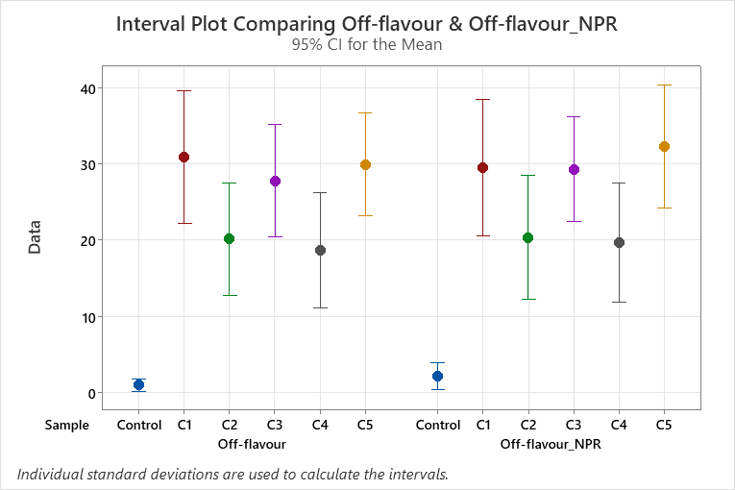
Off-flavour non-perception
16 panelists
50 samples + Control
3 always perceived off-flavour
12 sometimes perceived off-flavour
1 never perceived off-flavour

Slide 11
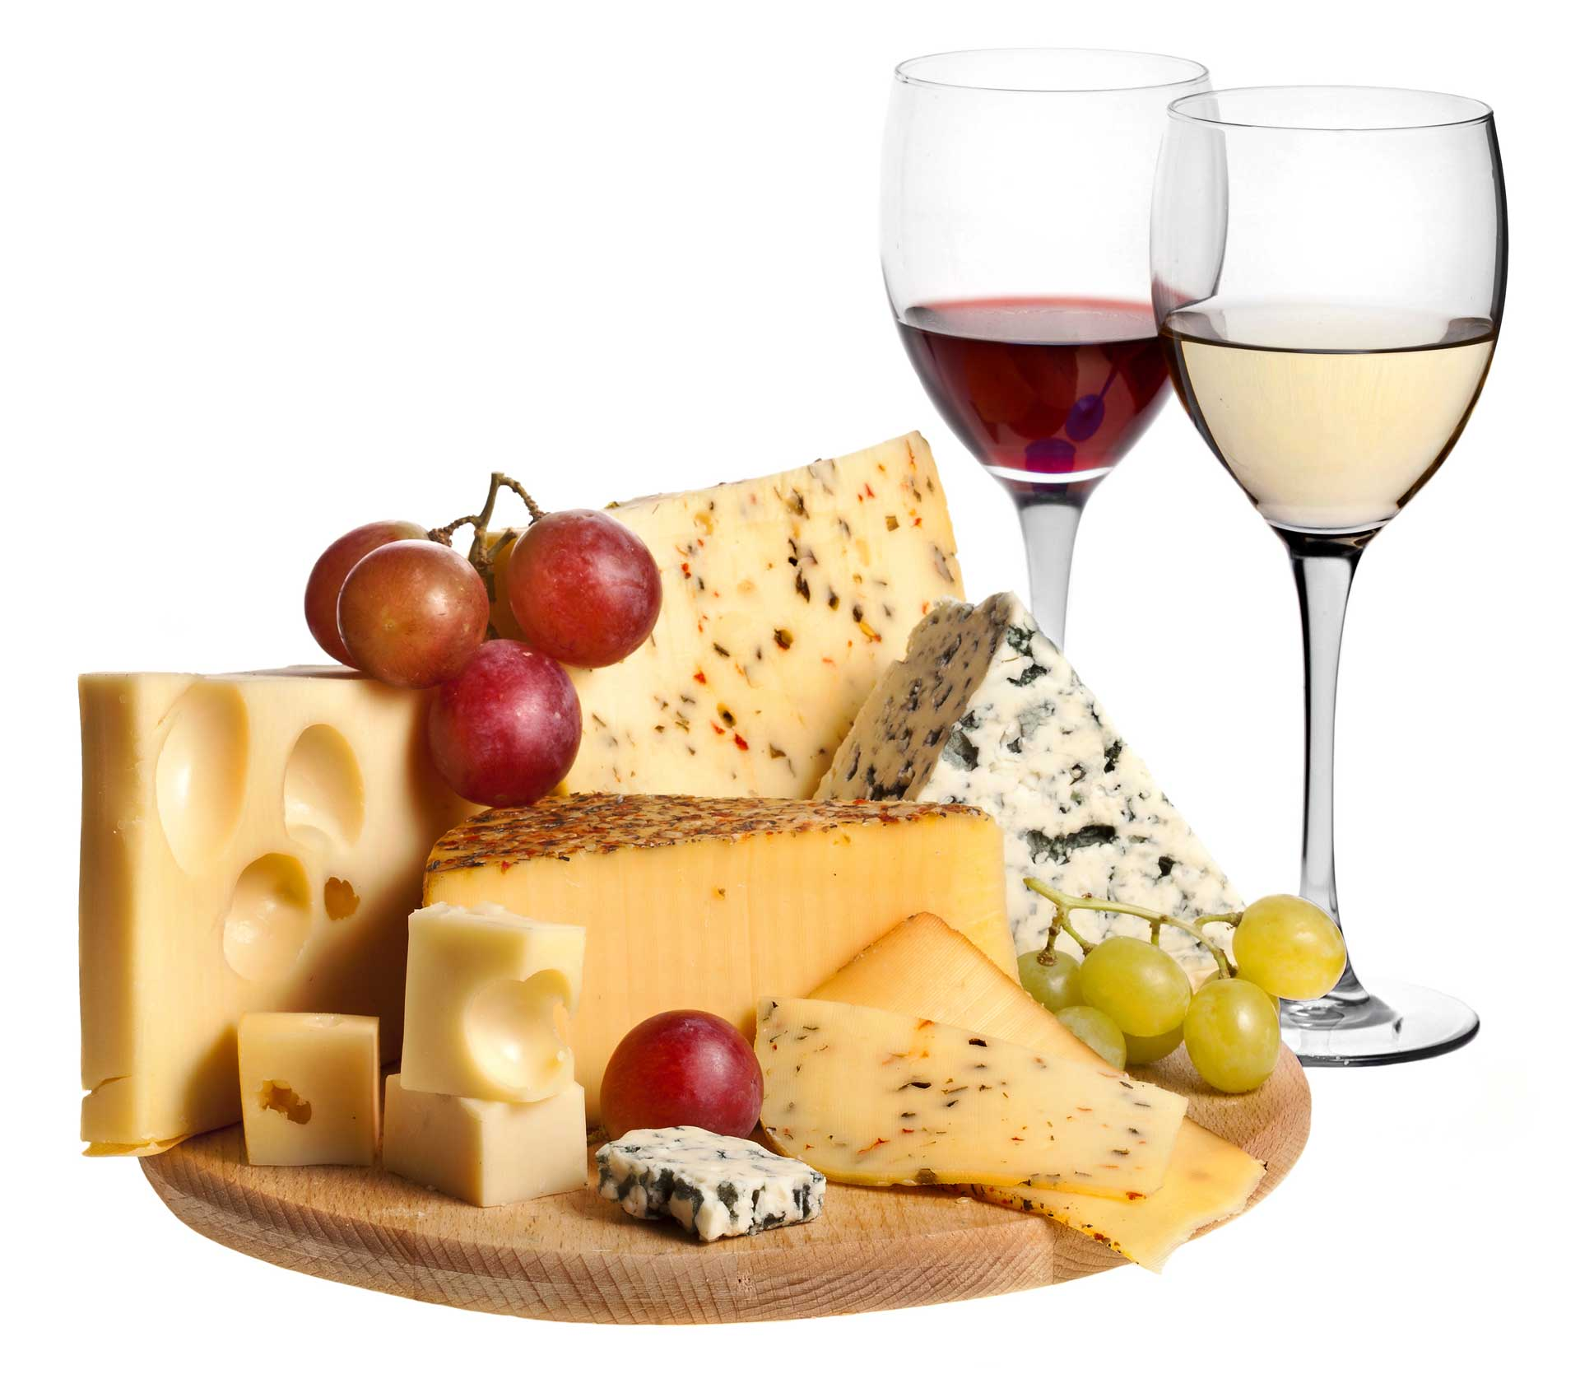
Presence / Absence
Non-detection ≠ Absence
The mean never tells the full story
The most perplexing data may be the most useful
Notes:
Strawberry + Oak barrel vs ‘red wine’

Slide 12
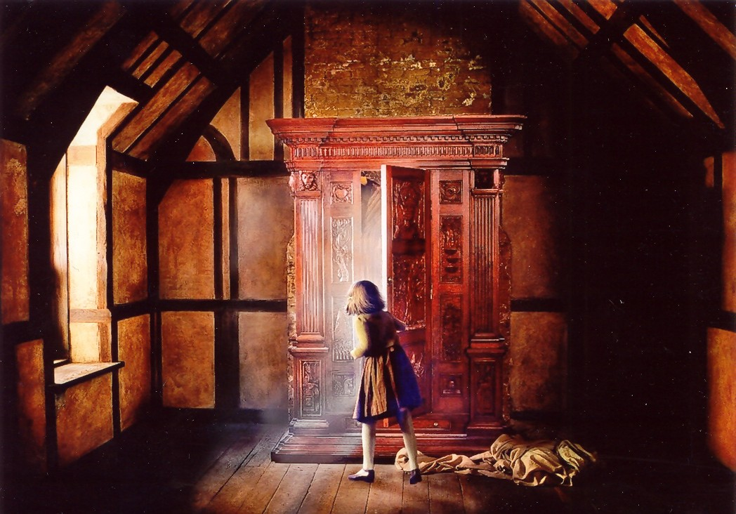
Non-perceivers tell a story

Slide 13

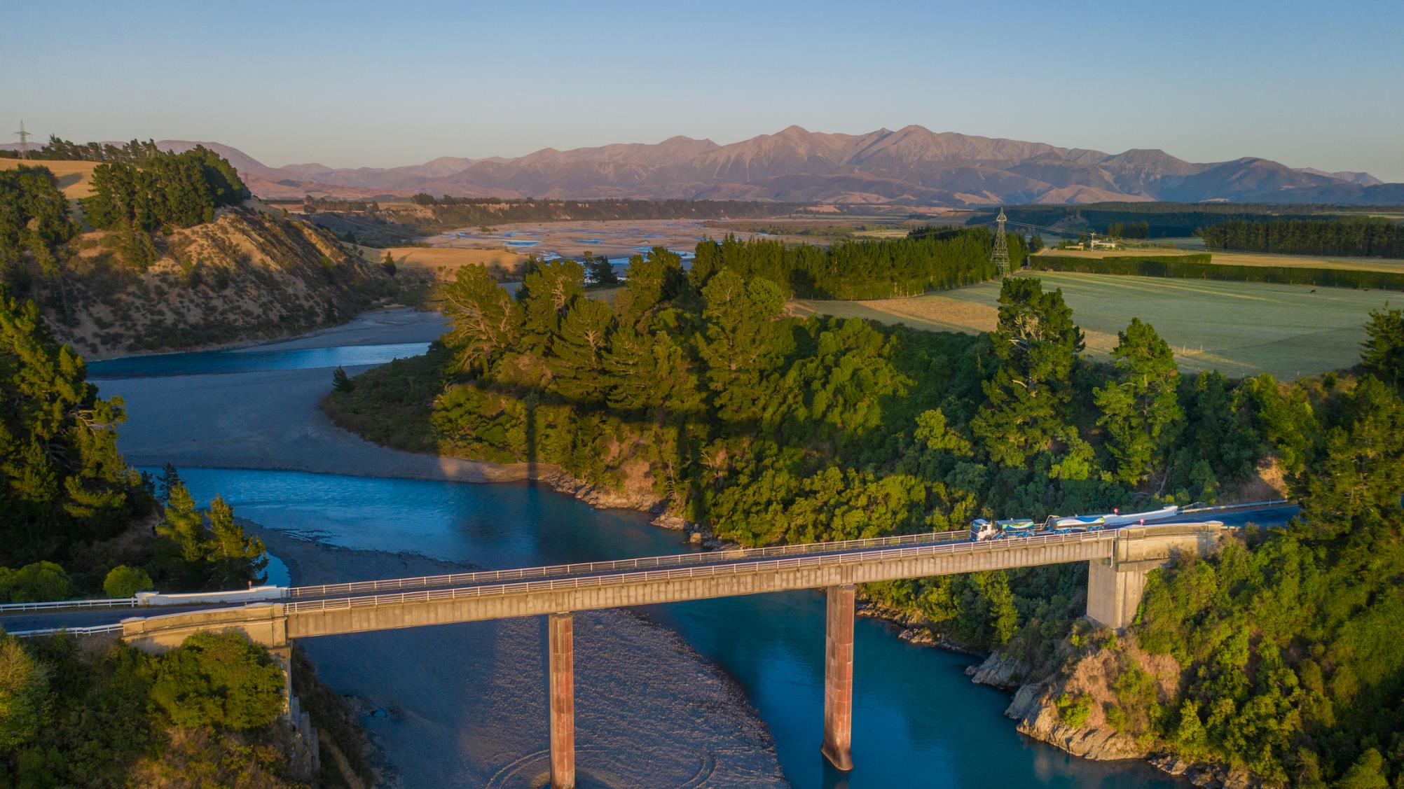

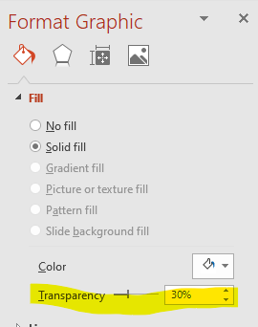

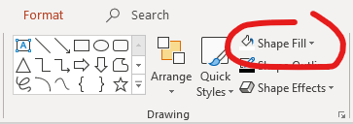

TRANSPARENCY 30%
TRANSPARENCY 60%
CHANGING THE TRANSPARENCY
You can change the transparency on the Flow shapes. These shapes have a recommended transparency percentage as indicated.
“Quotes go over several lines. If you have to go smaller than 28 points, you’re probably putting too much into the space.”
Questions?
WHITE FLOW
You can change the colour of this shape to one of the approved Fonterra Brand colours by using the "Shape Fill" button
TRANSPARENCY 40%
TRANSPARENCY 50%

